Slide 1
A Scalability Service for Dynamic Web Applications
Anastassia Ailamaki
Joint work with
Christopher Olston, Amit Manjhi, Charles Garrod, Bruce M. Maggs, Todd C. Mowry
Database Group
Carnegie Mellon University

Slide 2
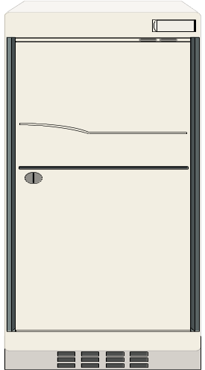
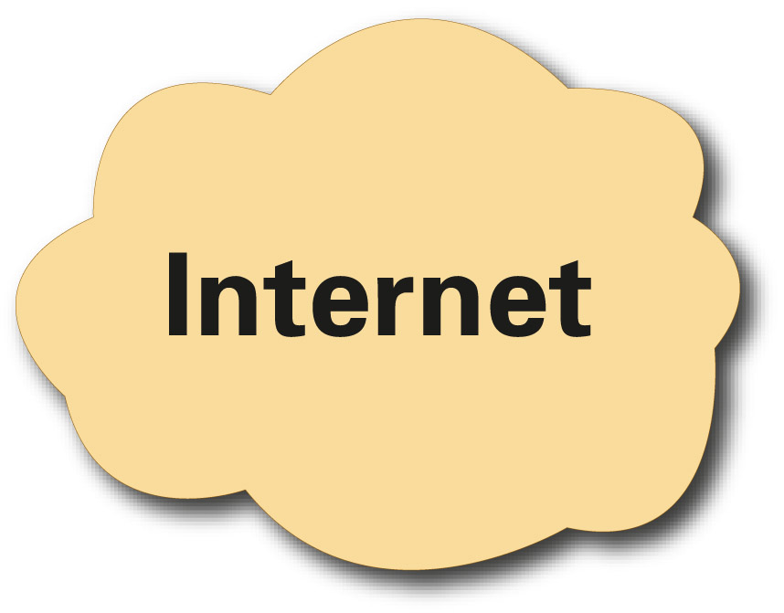
Today’s e-business infrastructure
Home server
Client
HTTP
App code
DBMS
Client
Web server
App server
Back-end
Database
Customers++??
  Invest in heavy-duty server infrastructure
  … OR …
  Risk inability to handle customer load
Need on-demand scalability
Notes:
Highlight that main cost behind #1 is *human management* cost.
Neither #1 nor #2 is appealing. #1 means that money could go down the drain if the customers don’t materialize. #2 means that customers may be turned away during a period of big hype, which could be catastrophic for business.

Slide 3
Example: Civic Emergency
Civic emergency: personalized instructions
  Collect reports from everyone
  Automatically develops evacuation routes
  Food, shelter locations
  Medical treatment locations
A web-based implementation?
Currently, impossible
  infeasible for each municipality to maintain substantial server infrastructure
Need dynamic content from DB backend
Notes:
Web-based implementation is “natural” for this kind of thing.
Again, main cost is management … plus in this case constant testing is needed to make sure it can cope with big spike -- more management cost.
From Charlie & Amit: I’m sure you can imagine a bunch of geeky computer scientists (read: Bruce) running around with their PDA’s and other toys probing the local web for emergency backup plans. As as example of the individualized dynamic content that the emergency management system might have, it could collect reports from the community and automatically develop evacuation routes (or maybe routes to acquire emergency supplies) that avoided dangerous areas (known gas leaks and structure fires, etc). We need to be clear that this is just a single example of an application that could be implemented on our system that is otherwise infeasible to implement today.

Slide 4
Solution: Third-Party Scalability Service
Proxy servers
Client
Home server
app
images
http
Client
DBMS
http
app
Client
Scalability as plug-in utility
“Pay per click” pricing
Cost linear to # customers
app
images
http
Client
No dynamic content from DB backend
Proposing: Distributed scalability service
Notes:
Akamai will run websphere/J2EE servlets for customers, but it does not provide scalable database servers.
Same architecture => Proxy server’s architecture mirrors that of origin server; proxy servers together constitute the “scalability service”
The architecture of a proxy server mirrors that of an origin server, with a web server and an application server to generate dynamic content. The main difference is that the proxy servers have a query cache instead of a database and communicates with the origin server only to issue updates and to serve cache misses.
The home server primarily houses code and data, while a set of proxy servers process client requests and execute programs. A client request is sent to a proxy server which then generates the appropriate response by a running a program, accessing locally cached code and data when possible, and obtaining additional code and data from the home server as necessary.
Primary rationale for choosing to cache the results of database queries is to make the proxy server independent of the back-end database implementation. This flexibility is required since different app. providers may choose different back-end databases. Another advantage is: complex queries need not be re-executed.

Slide 5
Talk Outline
Overview
Proposed Architecture
Related Work
Research challenges and approaches
  Scalable consistency management
  Security/scalability tradeoff
Initial workloads and prototype system
Conclusions and future work

Slide 6
Distributed Scalability Service Architecture
Proxy servers
Result
Cache
Client
images
Client
Home server
How to maintain cache consistency?
Result
Cache
Client
images
Client
Improved scalability (distributed)
Proxy can run same app code as server
Notes:
Same architecture => Proxy server’s architecture mirrors that of origin server; proxy servers together constitute the “scalability service”
The architecture of a proxy server mirrors that of an origin server, with a web server and an application server to generate dynamic content. The main difference is that the proxy servers have a query cache instead of a database and communicates with the origin server only to issue updates and to serve cache misses.
The home server primarily houses code and data, while a set of proxy servers process client requests and execute programs. A client request is sent to a proxy server which then generates the appropriate response by a running a program, accessing locally cached code and data when possible, and obtaining additional code and data from the home server as necessary.
Primary rationale for choosing to cache the results of database queries is to make the proxy server independent of the back-end database implementation. This flexibility is required since different app. providers may choose different back-end databases. Another advantage is: complex queries need not be re-executed.

Slide 7
Challenges in maintaining consistency
Requirements:
Strong consistency requirement
  (e.g., civic emergency)
  No TTL-based schemes
At-home updates
  Cannot apply existing replication algorithms
Insight:
Mostly reads
  Can handle all data modifications at server
Predefined update templates
  Strong consistency without burdening server
Proposed approach:
Template-based fully distributed consistency

Slide 8
Improved Scalability Service Architecture
users:
multicast-based consistency substrate
proxy servers:
scalability service
invalidator
read-only copies
master data
home servers:
Proxy overlay network maintains consistency
Notes:
As before, content is generated dynamically by the application cached at the proxy server, which mirrors the design of the origin server in the centralized architecture. Query results are cached at each proxy server in the form of materialized views. (We chose to cache query results in a standard format to make the proxy server independent of the implementation of the back-end database, since the proxy servers need to generate content from multiple content providers. This also greatly simplifies caching at the proxy since we just need to execute a simple lookup instead of doing our own query processing.) All updates are passed through to the appropriate origin server. The proxy servers are themselves connected by an overlay network to disseminate invalidation messages without the need for intervention by the origin server. (Updates from “normal” clients without proxy servers are also OK – the origin server uses the overlay network itself to issue invalidation messages when those updates occur.)

Slide 9
Related Work
Transactional replication [many]
Database caching for web applications, e.g.:
  IBM DBCache [Luo+ SIGMOD02] [Altinel+ VLDB03]
  IBM DBProxy [Amiri+ ICDE03]
  NEC CachePortal [Li+ VLDB03]
Invalidation methods for cached query results
  Query/update independence analysis, e.g., [Levy+ VLDB93]
  Data warehousing view maintenance, e.g., [Quass+ PDIS96]
  Caching for web applications [Candan+ VLDB02]
  Server handles updates
  None consider distributed consistency management
  Our focus: security vs. scalability tradeoff
Notes:
We are not inventing new invalidation methods

Slide 10
Talk Outline
Overview
Proposed Architecture
Related Work
Research challenges and approaches
  Scalable consistency management
  Security/scalability tradeoff
Initial workloads and prototype system
Conclusions and related work

Slide 11
Addressing consistency
TTL is wasteful:
  Often refresh cached data unnecessarily (workloads dominated by reads)
  Must set TTL=0 for strong consistency!
Solution: update or invalidate cached data only when affected by updates
  Naïve approach: home organizations notify proxy servers of relevant updates ← not scalable
Our approach:
Fully-distributed, proxy-to-proxy
update notification mechanism
Notes:
Say: strong consistency often necessary, especially in applications like civic emergency mgmt.

Slide 12
Distributed Consistency Mechanism
update
update notification
Multicast Environment
update notification
proxy node
Distributed app-level multicast environment, e.g. Scribe
Forward all updates to backend home servers
Transactional consistency T.B.D. (bi-directional messaging)
users
Notes:
When an update occurs, that update must be conveyed to all proxy servers caching views that might be affected by the update, so that they can either update or invalidate those views accordingly.
Fully-distributed application-level multicast environments available, e.g. Scribe (built upon Pastry DHT overlay)
Also point out that we continue to forward all updates to backend home servers.
Transactional consistency mechanism to build on top still T.B.D. (requires bi-directional messaging)

Slide 13
Configuring Multicast Channels
Key observation: Web applications typically interact with DB via a small, fixed set of query/update templates (usually 10-100)
Example:
SELECT qty FROM inv WHERE id = ?
UPDATE inv SET qty = ? WHERE id = ?
Templates: natural way to configure channels
Options:
Channel-by-query or Channel-by-update
Notes:
Base channels on query/update templates.
Natassa’s comment: Factor out all these problems and FORECAST in slide 9

Slide 14
Channel-by-Query Option
One channel per query template Q: C(Q)
Few subscriptions/cached result
Many invalidations/update
Begin caching result(s) of query template Q | Subscribe to C(Q)
Evict only query result for Q | Unsubscribe from C(Q)
Issue update | Determine which query templates Q₁, …, Q_{n} affected; send notification on each C(Q_{i})
Conflicts determined lazily (upon update)
Notes:
Say: each time an update occurs, access precomputed “conflict mapping” between update templates and query templates to decide which query templates might be affected
Fewer subscriptions/cached result, more multicast messages/update

Slide 15
Channel-by-Update Option
One channel per update template U: C(U)
Many subscriptions/cached result
Few invalidations/update
Begin caching result(s) of query template Q | Determine which update templates U₁, …, U_{n} affected; subscribe to each C(U_{i})
Evict only query result for Q | Unsubscribe from all C(U_{i}) above
Issue update using template U | Send notification on C(U)
Conflicts determined eagerly (when caching Q)
Notes:
SAY: channel-by-query preferable for read-dominated workloads
[If asked … Caveat: the cost of channel-by-query vs. channel-by-update depends on many factors (where stuff is cached, cost of subscribing/unsubscribing, cost of applying query/update mapping, etc.)]

Slide 16
Parameter-Specific Channels
Optimization: consider parameter bindings supplied at runtime … for example:
Q5: SELECT qty FROM inv WHERE id = ?
  When issued with id = 29, create extra parameter-specific channel C(5, 29)
  Subscribe to both C(5) and C(5, 29)
Upon update:
  If update affects a single item with id = X, send notification on channel C(5, X)
    Saves work if X ≠ 29
  Updates affecting multiple items sent to C(5)
Notes:
Q5 means “query template #5”
Channel identifier for C(5,29) formed by applying a hash function to the combination of those numbers; note that collisions do not affect correctness
… this is ongoing work. Situation gets more complicated with disjunction, conjunction of predicates, etc.

Slide 17
Update or Invalidate?
Upon notification of update, should a proxy update or invalidate its local cached data?
Our choice driven by practical considerations:
  Administrators reluctant to cede control of data
  No data modification should take place outside application provider sphere of control
  → use invalidation
Currently investigating adaptive policies
Notes:
Why administrators reluctant to cede control: there’s a general fear that if another party takes care of updating data they might screwing up somehow, leading to corrupted data. Plus there’s risk of malicious data modification (e.g., enemy increases your inventory numbers so you oversell and piss off your customers). Since data is a core asset of e-commerce companies, this risk is simply unacceptable.

Slide 18
Talk Outline
Overview
Proposed Architecture
Related Work
Research challenges and approaches
  Scalable consistency management
  Security/scalability tradeoff
Initial workloads and prototype system
Conclusions and related work

Slide 19
How does security affect scalability?
Scalability service shared by many organizations
  Security and privacy: key concerns
To minimize chance of accidental disclosure:
  Application providers can encrypt data before sending to proxy servers to be cached
However, encryption forces conservative cache management decisions
  → more invalidations than necessary
Encryption inhibits scalability

Slide 20
Example: Inspecting Cached Data
CREATE VIEW MyView(Author, Awards)
AS
SELECT A.Author, A.Awards
FROM Authors A, Books B
WHERE B.Author = A.Author
AND A.Country = "USA"
AND B.Subject = "history"
UPDATE Authors SET Country="France”
WHERE Author="Tocqueville"
YES
UPDATE Books SET Subject="fiction”
WHERE Title="Napoleon's Television"
NO
Security-scalability tradeoff
Notes:
With the first update, there is an advantage to inspecting the cached query result -- if Tocqueville is absent, then no need to invalidate.
With the second update, there is *no* advantage to inspecting the cached query result.

Slide 21
Resolving the tradeoff
No one-fits-all solution
Naïve approach: black-box
Or, switch between methods
  Inspect data for low-security customers
  Statement-based (low-scalability) for high-security customers
Really, three access classes:
black-box, view-data-access, full-data-access
Need quantitative estimate of impact
on scalability

Slide 22
Ongoing Tradeoff Analysis Work
Problem:
Given a workload, how many invalidations incurred with and without the ability to inspect cached query results?
Work completed: formal characterization of view invalidation alternatives (see paper)
Current focus: identifying restricted classes of workloads for which there is provably no advantage to accessing cached data
Notes:
Using our technique, by inspecting the query and update templates, we can a-priori figure out whether there is any advantage to inspect cached query results or not. If not, then encryption is best.

Slide 23
Talk Outline
Overview
Proposed Architecture
Related Work
Research challenges and approaches
  Scalable consistency management
  Security/scalability tradeoff
Initial workloads and prototype system
Conclusions and future work

Slide 24
Testbed Application Workloads
Bookstore (TPC-W, from UW-Madison)
  Online bookseller, a standard web benchmark
  Changed book popularity from uniform to Zipf
    (according to study on Amazon.com)
Auction (RUBiS, from Rice)
  Modeled after Ebay
Bulletin board (RUBBoS from Rice)
  Modeled after Slashdot
Workloads represent popular websites
Notes:
RUBiS and RUBBoS are from researchers at Rice University, TPC-W implementation from Wisconsin.

Slide 25
Initial Working Prototype
Tomcat as web server/servlet container
MySQL4 as a database backend
Queries: access cached data when possible
  Caching granularity = JDBC query results (i.e., materialized views)
    index recults using their JDBC representation
  TTL-based consistency
    not transactional semantics (see paper for ideas)
    set TTL=0 for sensitive data
Updates: sent to home server
Initial design choices to identify bottlenecks
Notes:
Simple and conservative consistency model -- all query templates are either uncacheable or cacheable with fixed time-to-live. Examples: latest bid on an item in auction, number of copies of a book in stock (TTL = 0). Cacheable: Ten best sellers in bookstore. Final goal is to mark all data as cacheable.
Emphasize that all of this is to get a simple prototype working -- doesn’t necessary match ultimate design decisions

Slide 26
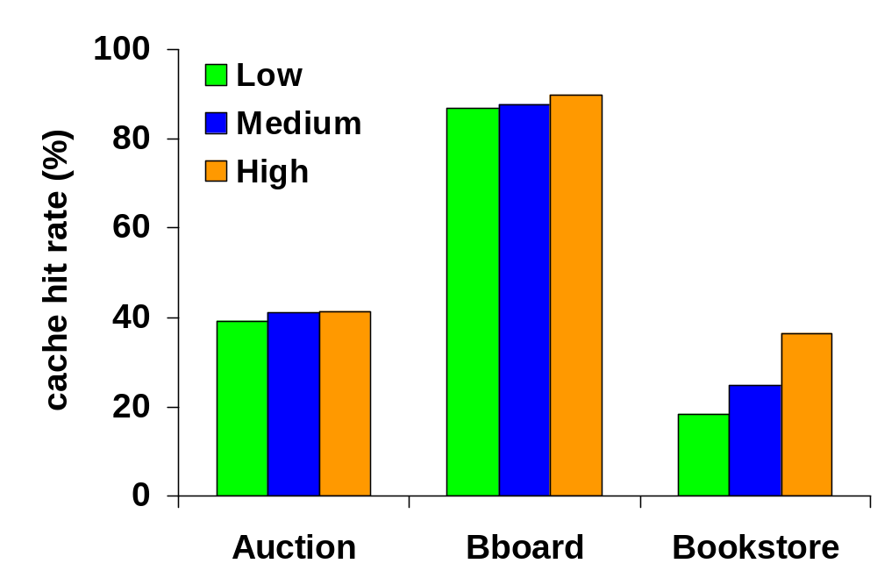
Cache hit rates
AUCTION
990MB
33,500 items
100,000 users
BBOARD
1.4GB
213,000 comm
500,000 users
BOOKSTORE
217MB
10,000 items
86,400 users
Bookstore: low commonality
(possible solution: collaborative caching)
Auction: 50% uncacheable
(essentially, TTL=0)
Distributed Consistency Management:
on-demand invalidation

Slide 27
Future Work
Always invalidating cached data in response to updates places bounds on scalability
Goal: unlimited scalability
Move to weak consistency as needed
  Selectively neglect to invalidate cached data
Load-aware cache management
  e.g., do not evict data of overloaded applications
Collaborative caching
  Retrieve data from other proxies upon cache miss

Slide 28
Conclusions
Context: Dynamic web applications
Goal: Offer scalability as a plug-in service
Approach: Network of cooperating proxies that serve cached data on behalf of applications
Expected results:
  Distributed consistency management using multicast
  Formal characterization of security/scalability tradeoff
  Improved scalability in distributed service architectures

Slide 29
Thank you! http://www.cs.cmu.edu/S3
users:
multicast-based consistency substrate
proxy servers:
scalability service
invalidator
read-only copies
master data
home servers:

